Slide 1
WMRApp presentation
Thanh-Tung Pham
Yasser Soofiyani

Slide 2
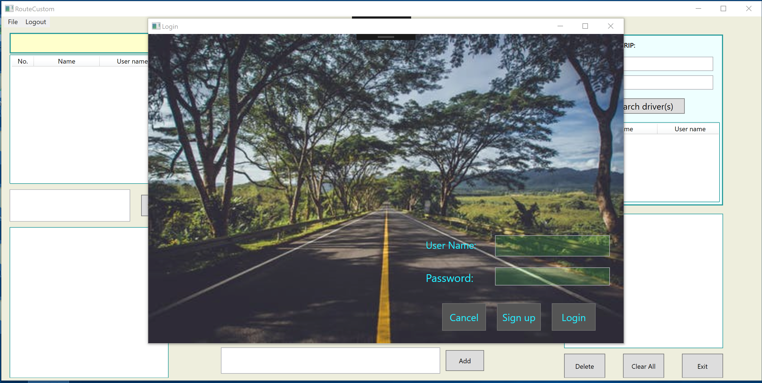
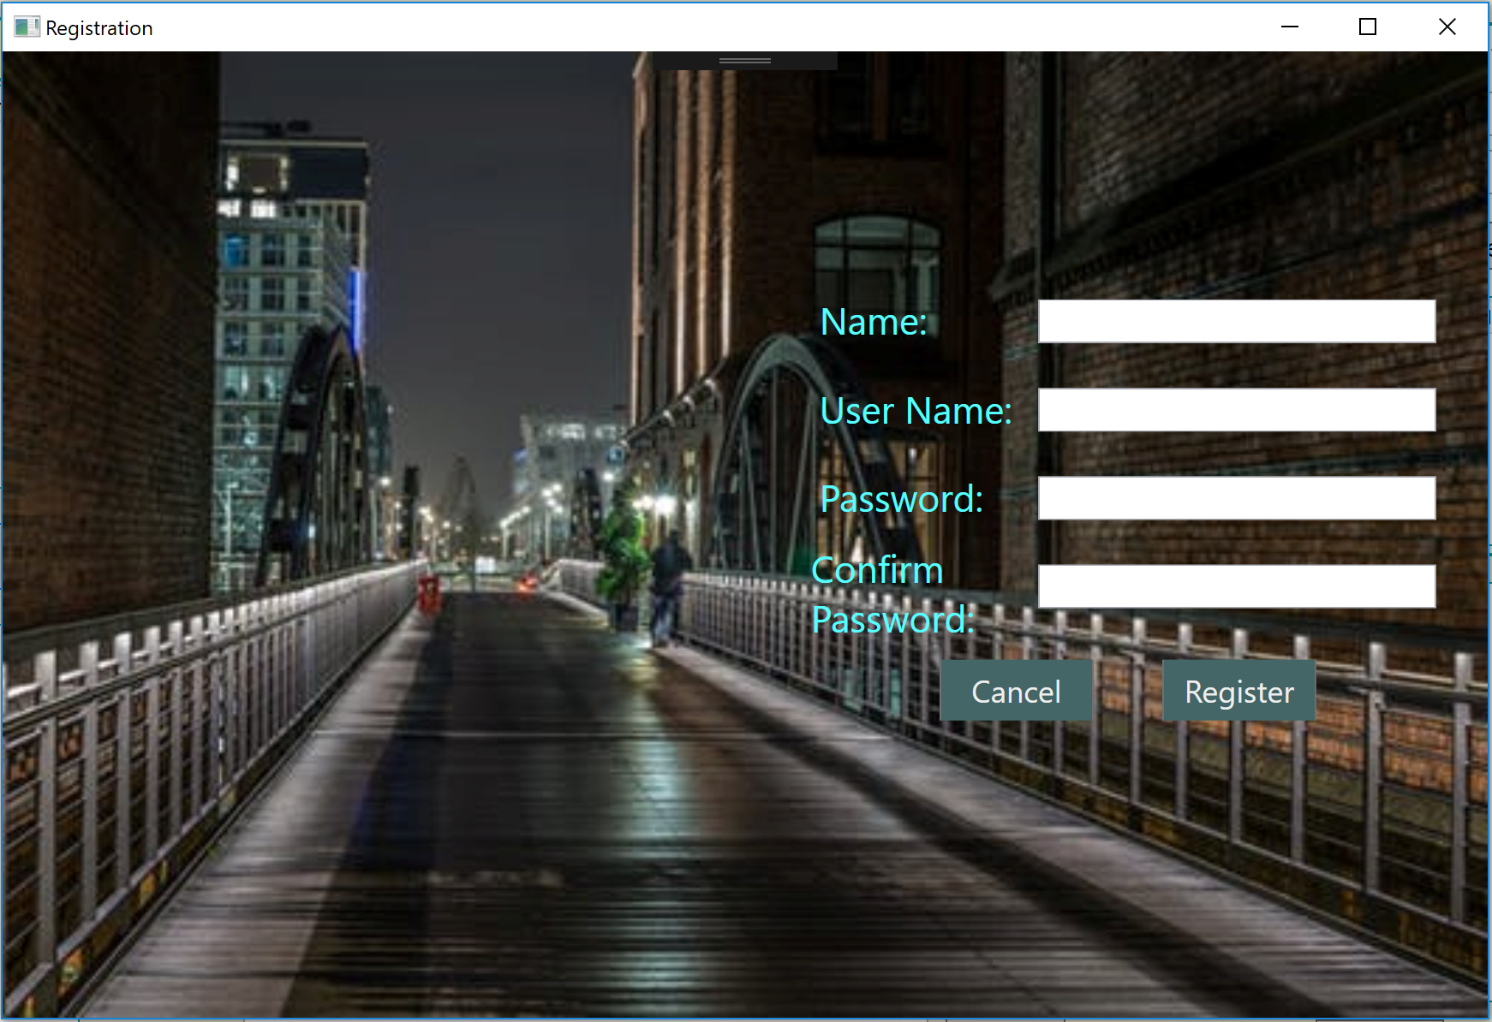
Background

Slide 3
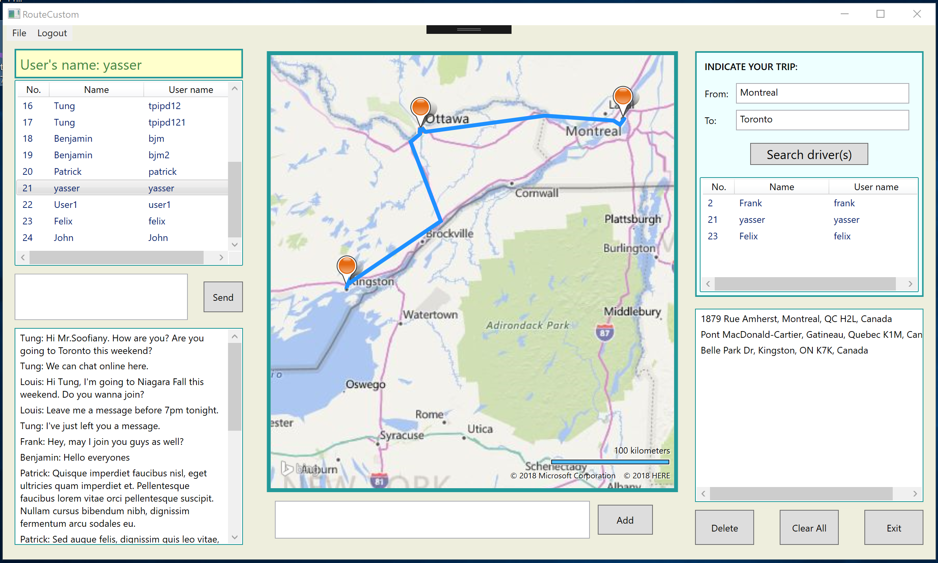
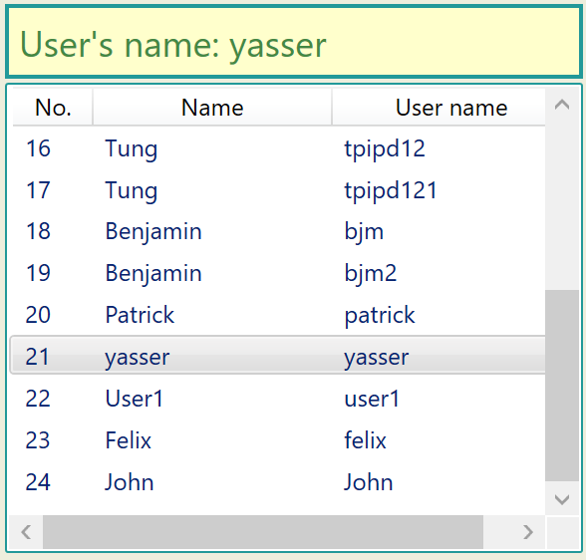
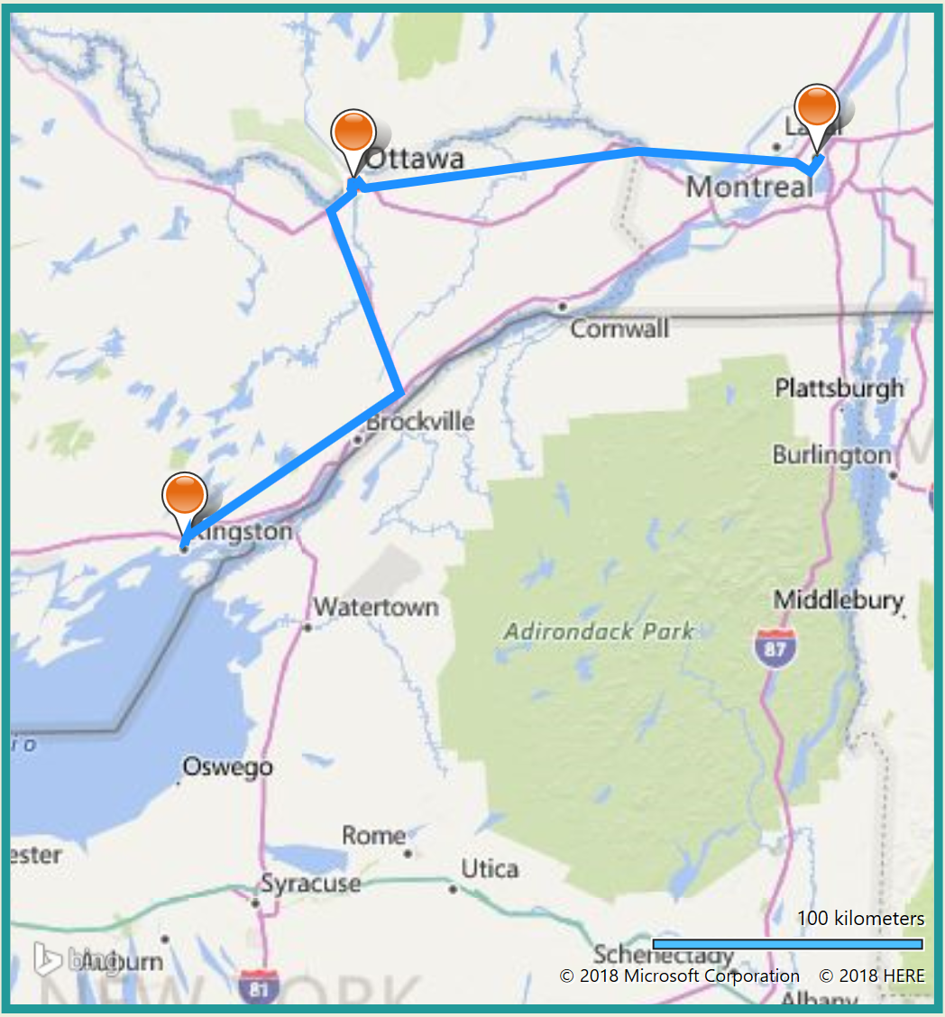
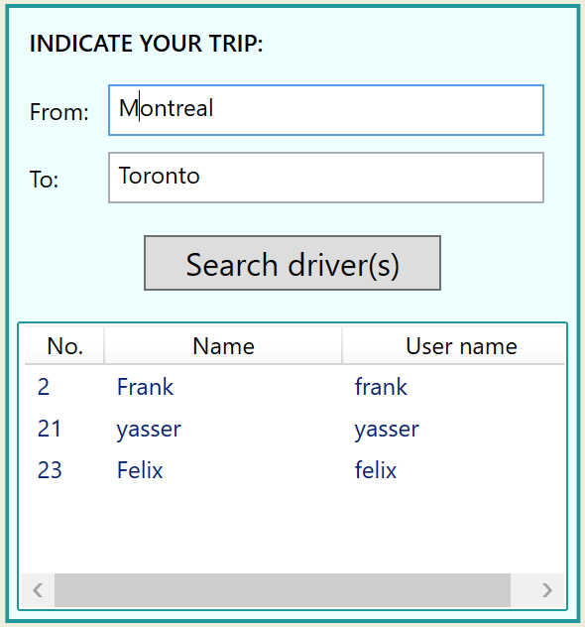
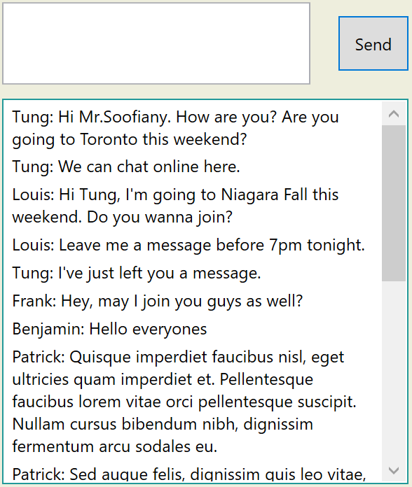
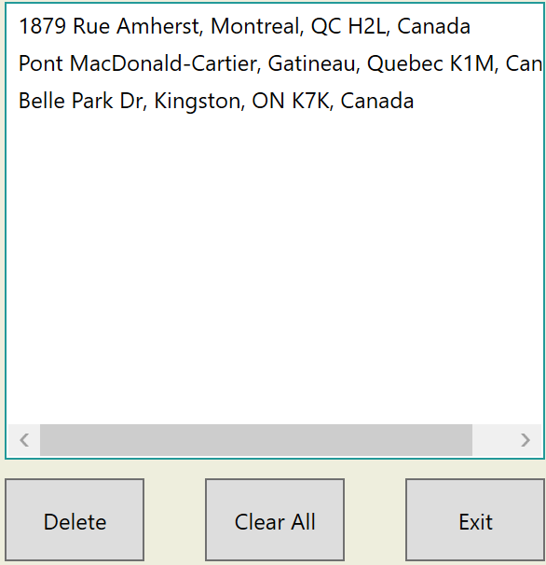
Background

Slide 4
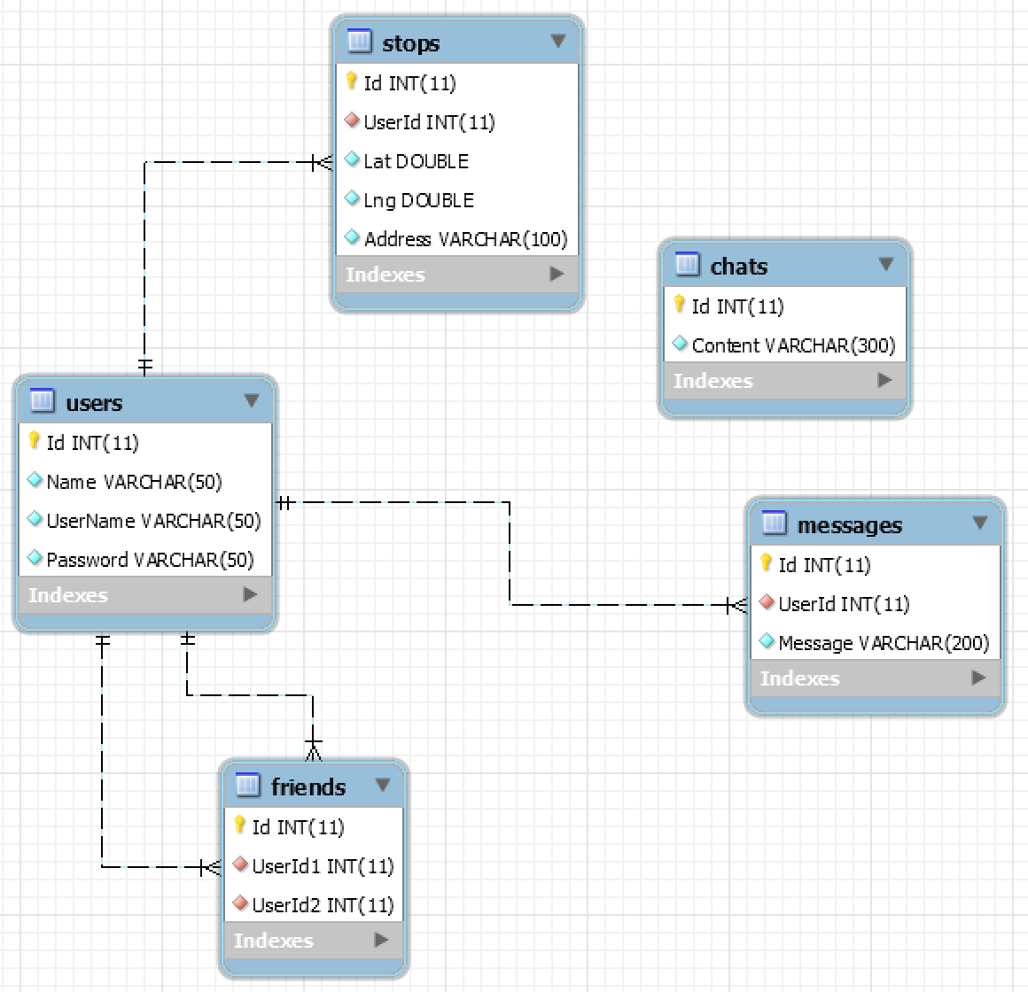
Database

Slide 5
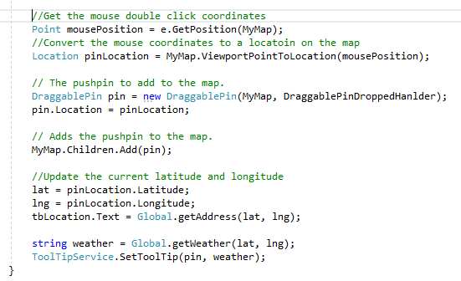
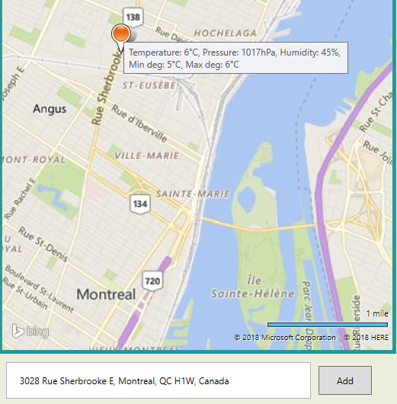
Pick a location

Slide 6
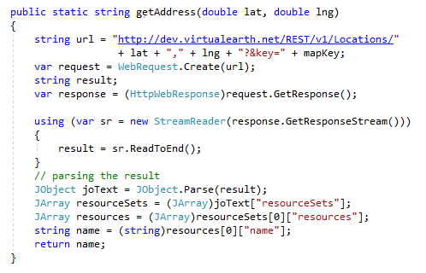
Get Address
getAddress() method invoked from Global class

Slide 7
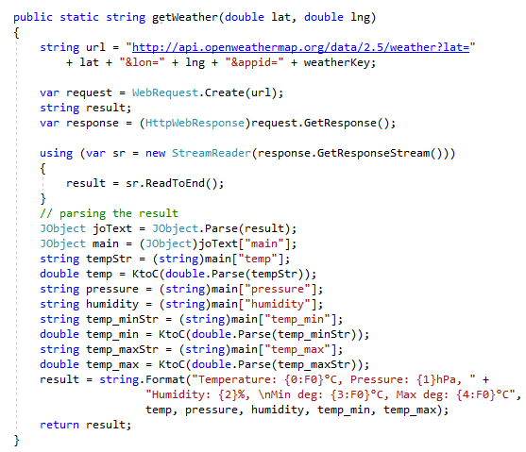
getWeather() method invoked from
Global class.

Slide 8
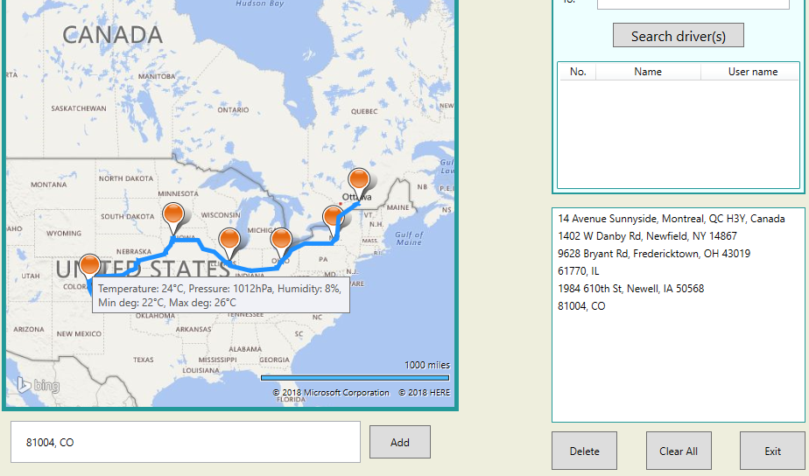

Slide 9
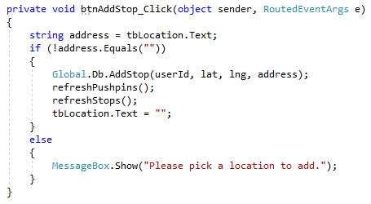
btnAddStop_Click() method in Code behind

Slide 10
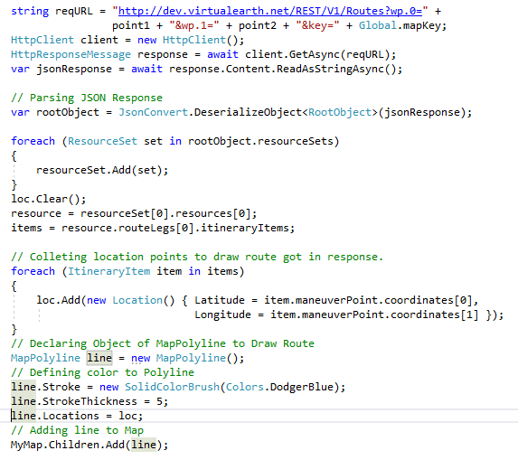

Slide 11
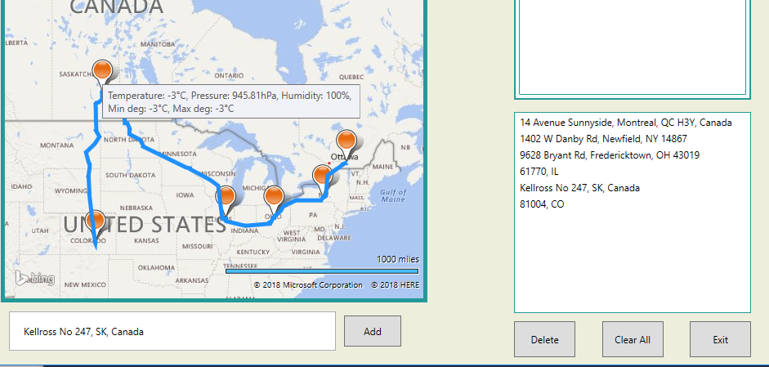
Dragging, dropping a pushpin

Slide 12
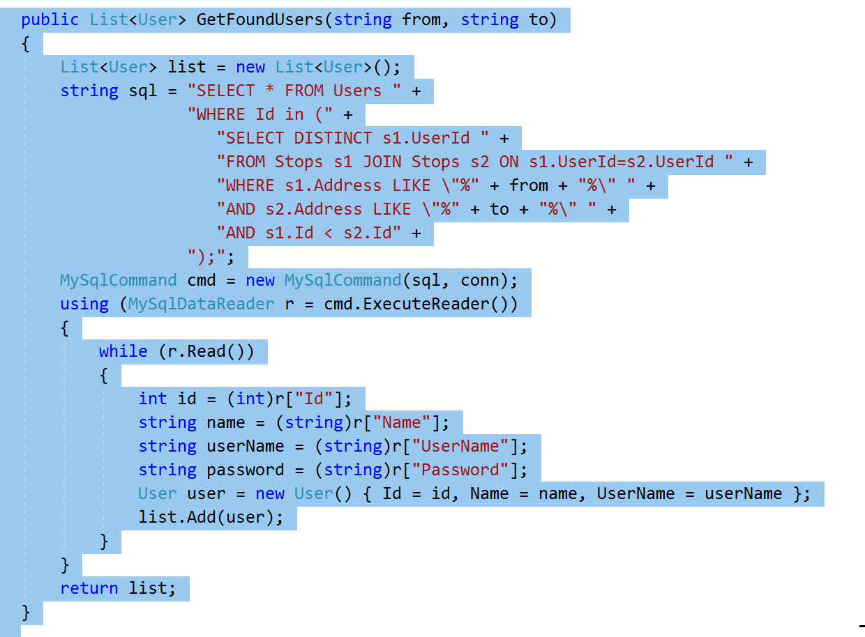
Trip Search

Slide 13

Summary
References:
https://msdn.microsoft.com/ja-jp/library/hh709044.aspx
https://msdn.microsoft.com/en-us/library/ff701710.aspx
https://openweathermap.org/current#current_JSON
https://rbrundritt.wordpress.com/2010/05/04/simple-infoboxes-in-bing-maps-silverlight/
https://rbrundritt.wordpress.com/2009/08/01/ve-silverlight-control-%E2%80%93-pushpins-infoboxes-and-best-map-view/
https://code.msdn.microsoft.com/windowsapps/Draw-Route-using-Bing-Maps-4a6ad1e7
https://jsonformatter.curiousconcept.com/
Special thanks to Mr. Prokopski.

